Slide 1
EV Sales by State in India
An in-depth analysis of electric vehicle sales trends across various states in India.
This analysis highlights the top 10 electric vehicle (EV) sales records across Indian states, with a specific focus on vehicle category. The data reveals that 3-Wheelers dominate the EV market, particularly in Uttar Pradesh, which appears consistently as the top-performing state. Maharashtra also shows strong figures, indicating its significant contribution to EV adoption.
By analyzing EV sales quantities for each state and vehicle category, this view helps identify regional preferences and market trends, aiding policymakers, manufacturers, and stakeholders in making data-driven decisions to promote EV usage and infrastructure.
--By Shaik Naveed

Slide 2
Problem Statement
Despite the growing adoption of electric vehicles (EVs) across India, understanding the state-wise distribution and category-specific trends in EV sales remains a challenge. Stakeholders such as government bodies, EV manufacturers, and infrastructure planners require data-driven insights to identify high-performing regions and prioritize investments.
This analysis aims to identify the top-performing states in terms of EV sales, with a focus on vehicle categories, to uncover which regions and EV types are driving the market. By examining the top 10 EV sales records based on state and vehicle category, the goal is to:
Recognize regional trends and adoption patterns
Highlight the dominant vehicle categories in EV sales
Provide actionable insights for EV policy and infrastructure development

Slide 3
Technologies Used
1. MySQL
For storing, managing, and querying EV sales data.
Used advanced SQL queries including RANK() OVER(), aggregations, and filtering.
2. SQL Window Functions
Applied RANK() to find top 3 states per year based on sales quantity.
Used ORDER BY, GROUP BY, and subqueries for advanced insights.
3. EV Sales Dataset
Contains attributes like Year, Month, Date, State, Vehicle Class, Vehicle Category, Vehicle Type, and Sales Quantity.
Used as the core data source for the analysis.

Slide 4
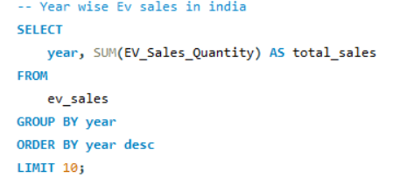
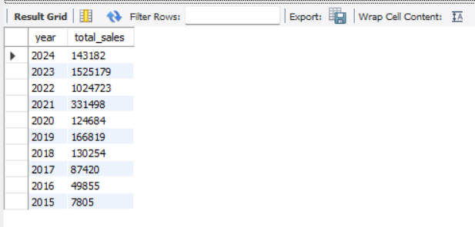
01
Year Wise Total EV Sales

Slide 5
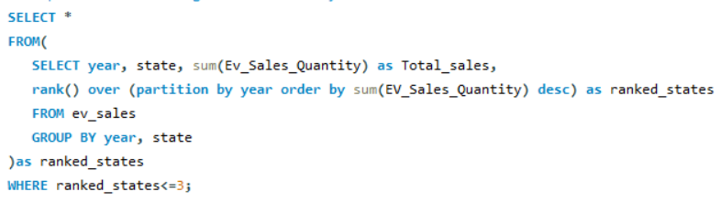
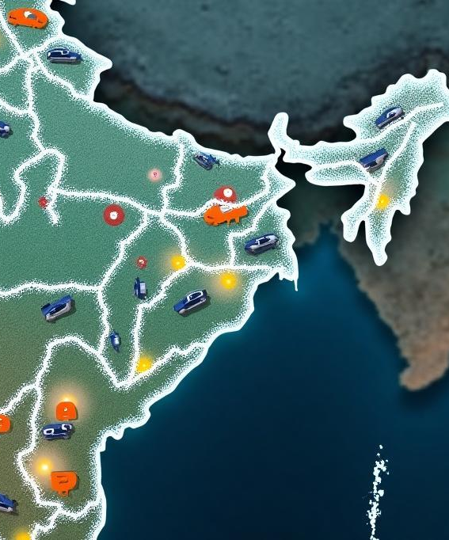
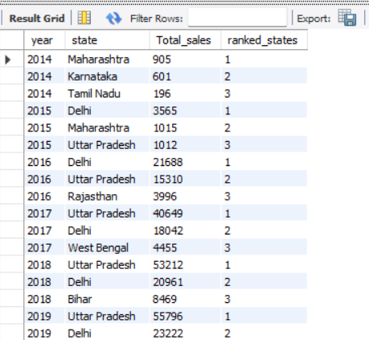
02
Top 3 States With Highest Sales

Slide 6
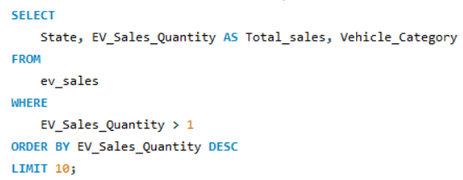

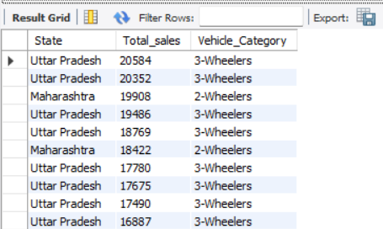
03
3 Wheeler Domination States

Slide 7
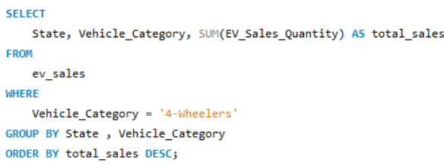
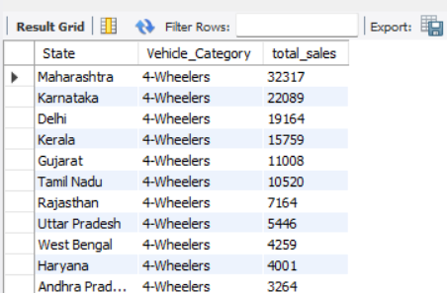
04
4 Wheeler Domination States

Slide 8
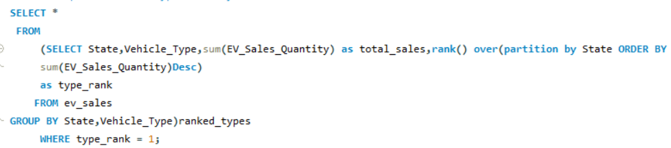
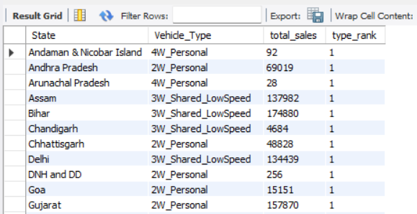
05
Most Popular Vehicle Type Wise Sales

Slide 9
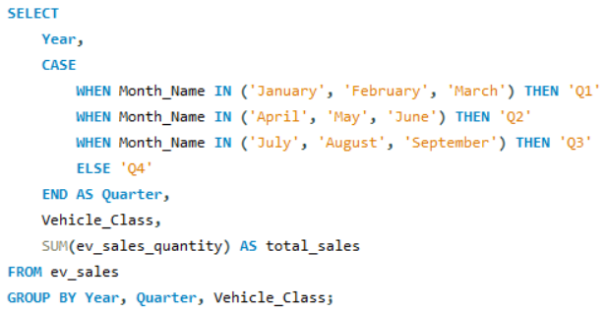
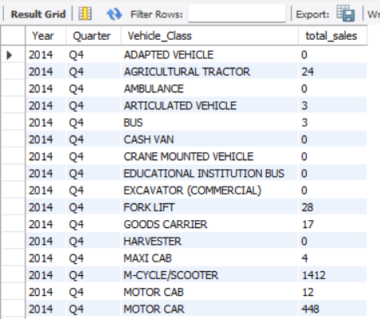
06
Quarter Wise Sales

Slide 10
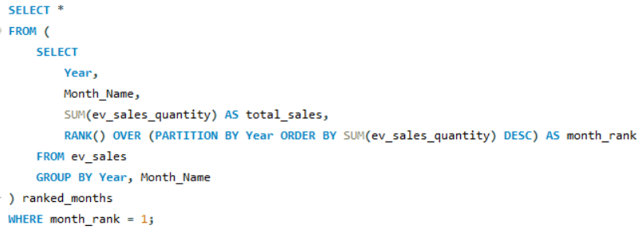
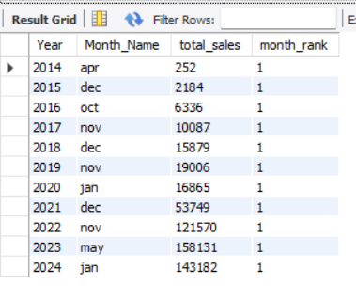
07
Highest Selling Month ForEach Year

Slide 11
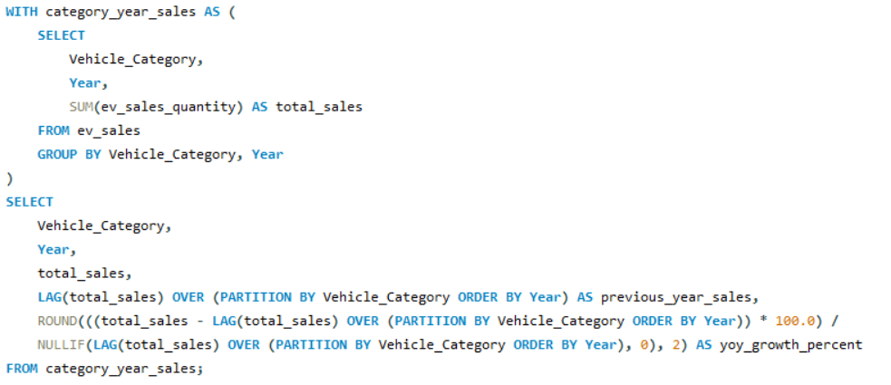
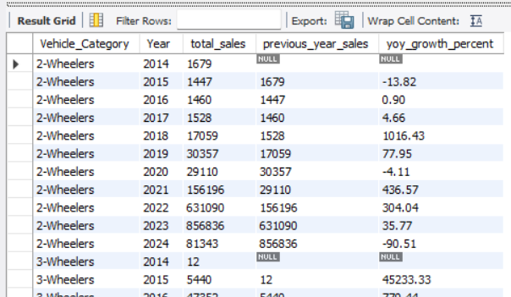
08
Year Over Year Growth By Vehicle Category

Slide 12
Future Projections by Region
Future projections indicate sustained growth in the Indian EV market, with expectations of increased sales in states with favorable policies and infrastructure. Regions like Karnataka and Gujarat are likely to see significant upticks as they invest in cleaner technologies and expand their EV frameworks, potentially leading to a more balanced distribution of EV sales across the country.

Slide 13
Conclusion
The electric vehicle market in India is poised for dynamic growth, underpinned by strong government support and increasing consumer awareness. Key states are leading the way in sales, but a collaborative effort towards infrastructure development and consumer education will be essential to ensure the long-term success and sustainability of EVs in India.

Slide 14

Thank you!
-- by Shaik Naveed
Do you have any questions?

